Slide 1

DriverPass System Analysis
Karina Washington
Notes:
[No speaker notes required for this slide.]

Slide 2

System Requirements
Appointment Scheduling:
The system should allow customers to schedule, modify, and cancel driving lesson appointments efficiently.
The secretary should be able to view, confirm, and modify customer appointments.
Security Management:
The IT officer should be able to log into the system securely to manage security settings.
The system should provide functionality for the IT officer to view security logs, manage employee roles, and update security protocols.
Nonfunctional Requirements:
Data Security:
The system must implement robust data security measures, including encryption of data transmission, secure storage practices, access control, and authentication mechanisms.
Regular security updates and compliance checks with industry standards are required to safeguard sensitive customer information.
Scalability and Responsiveness:
The system should operate as a cloud-based application to ensure scalability and responsiveness, accommodating varying user loads and demands.
Cloud infrastructure should efficiently allocate resources, maintaining performance and reliability even with a growing user base.
Notes:
[In your speaker notes, include an explanation of the different requirements you determined for DriverPass’s system. What are the functional requirements you selected to describe? What are the nonfunctional requirements you selected to describe? Be sure to explain how these requirements meet DriverPass’s needs.]

Slide 3
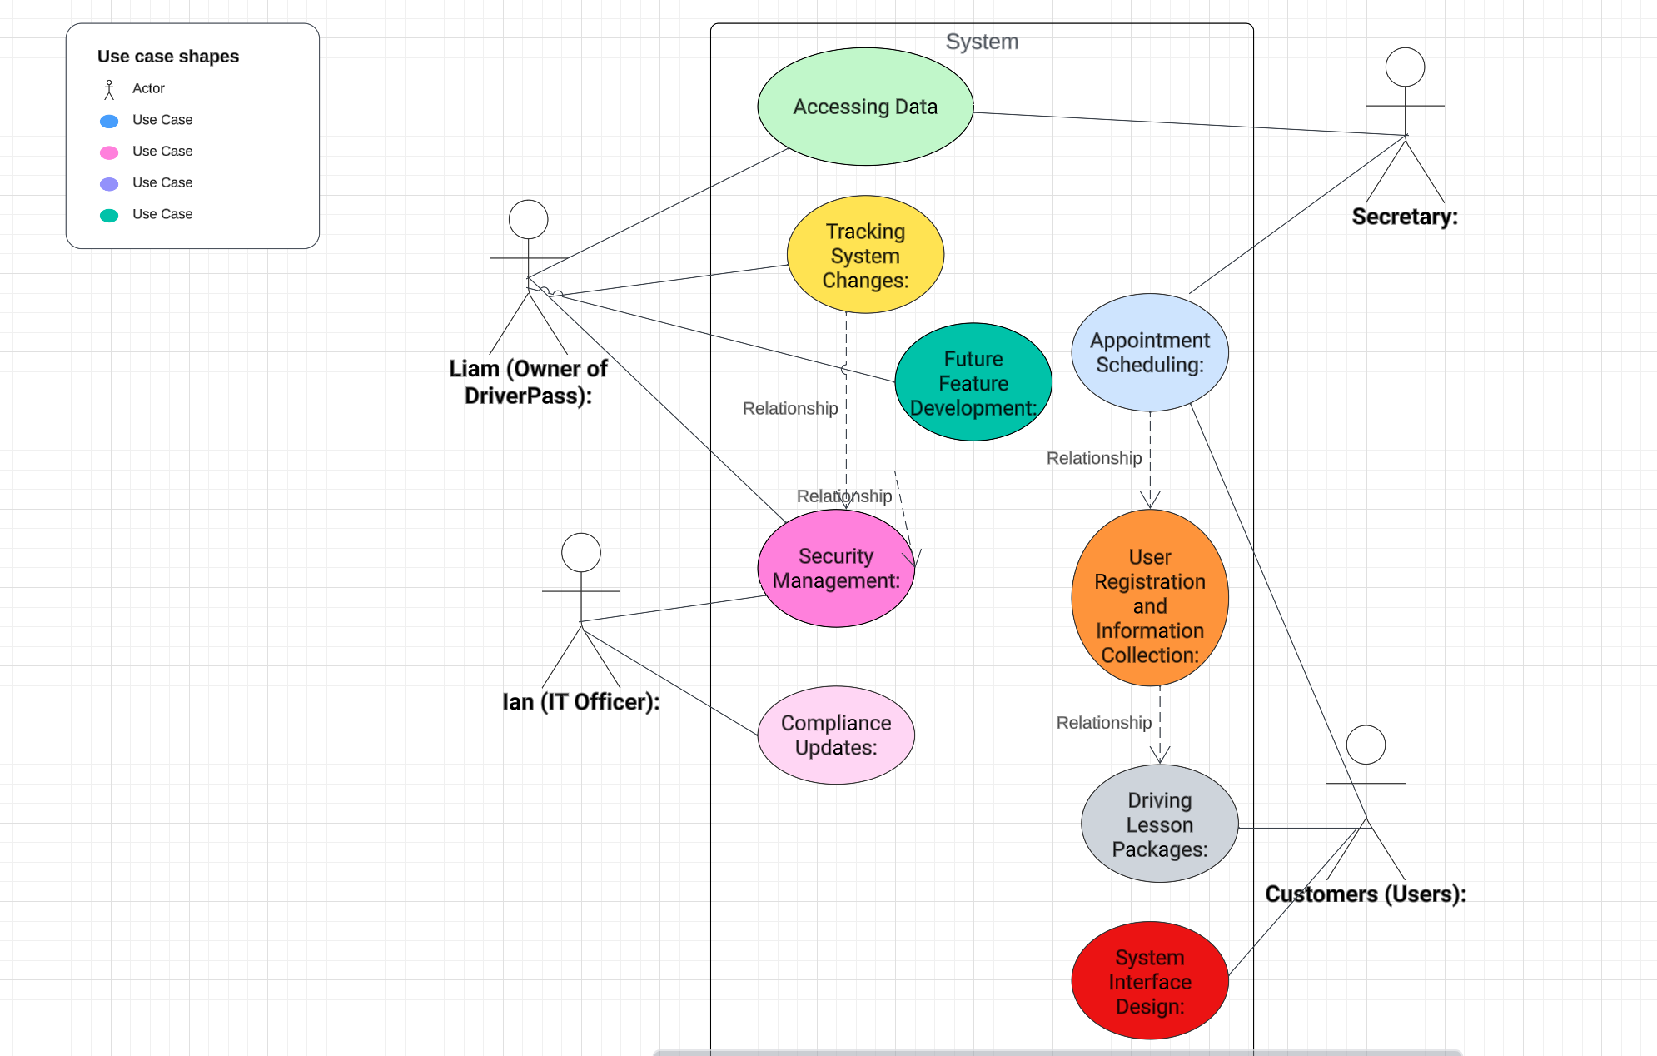
Use Case Diagram
Notes:
[Explain your diagram. Who are the different actors in the system? What are the different use cases? How did you account for DriverPass’s needs in your design? In your explanation, keep your audience in mind. Avoid the use of terms like “actors” and “use cases” in your explanation.]

Slide 4
Activity Diagram
+------------------+ +------------------+
| Customer | | Secretary |
+------------------+ +------------------+
| |
| requestAppointment() |
|----------------------------------->|
| |
| confirmsAppointment() |
|<-----------------------------------|
| |
| modifyAppointment() |
|----------------------------------->|
| |
| cancelAppointment() |
|<-----------------------------------|
Notes:
[Explain your diagram. Which use case are you breaking down? What are the steps for this use case? How did you account for DriverPass’s needs in your design? In your explanation, keep your audience in mind. Avoid the use of technical terms such as “nodes,” “control flows,” and so on.]

Slide 5
Security
Security Measures in DriverPass System Design:
Data Encryption:
All sensitive customer information, including personal details and credit card data, will be encrypted during data transmission.
Encryption protocols will be implemented to ensure secure communication between users and the system.
Secure Storage Practices:
The system will employ secure storage practices to safeguard customer data in the database.
Hashing algorithms may be used to protect sensitive information, such as passwords, stored in the system.
Access Control:
Access control mechanisms will be implemented to ensure that only authorized personnel can access specific functionalities within the system.
Different user roles (Customer, Secretary, IT Officer) will have defined access privileges based on their responsibilities.
Authentication Mechanisms:
The system will incorporate secure user authentication mechanisms, such as multi-factor authentication, to verify the identity of users.
Strong password policies will be enforced to enhance the security of user accounts.
Regular Security Updates:
The system will undergo regular security updates to patch vulnerabilities and address emerging threats.
Compliance checks with industry standards will be conducted to ensure that the system aligns with the latest security best practices.
Notes:
[How did you consider security in your design? In your explanation, keep your audience in mind by avoiding the use of technical terms.]

Slide 6
System Limitations
Limitations of the DriverPass System:
Dependency on Internet Connectivity:
The system heavily relies on internet connectivity as it operates as a cloud-based application. Users may experience limitations in functionality or access during internet outages.
Learning Curve for Users:
The introduction of a new system may pose a learning curve for users, including customers, retailers, and the IT officer. Adequate training and user-friendly interfaces will be crucial to mitigate this limitation.
Mobile Accessibility:
While the system is designed to be responsive, limitations may exist in the user experience on certain mobile devices. Optimization for various screen sizes and resolutions may be an ongoing challenge.
Initial Setup Complexity:
Implementing and configuring the cloud-based infrastructure may introduce complexity during the initial setup. Proper documentation and support mechanisms will be essential to assist system administrators.
Limited Feature Set for Secretary Role:
The system's current design may provide limited features for the secretary role. Future enhancements might be required to expand functionality and streamline secretary operations.
Notes:
[What are the limitations of your design? In your explanation, keep your audience in mind by avoiding the use of technical terms.]

